Slide 1
Diagnostic Studies

Slide 2
Urine Analysis
pH
Specific gravity
Protein
Sugar
Microscopic examination
Ketone bodies

Slide 3
pH of Urine
The glomerular filtrate of blood is acidified by the kidneys
From a pH of approximately 7.4 to a pH of about 6 in the urine.
Depending on the person's acid-base status, the pH of urine may range from 4.5 to 8.
The kidneys maintain normal acid-base balance primarily through the reabsorption of sodium and the tubular secretion of hydrogen and ammonium ions.

Slide 4
pH of urine (contd)
A highly acidic urine pH occurs in:
Acidosis
Uncontrolled diabetes
Diarrhea
Starvation and dehydration
Respiratory diseases in which carbon dioxide retention occurs and acidosis develops

Slide 5
A highly alkaline urine occurs in:
Urinary tract obstruction
Pyloric obstruction
Salicylate intoxication
Renal tubular acidosis
Chronic renal failure
Respiratory diseases that involve hyperventilation (blowing off carbon dioxide and the development of alkalosis)

Slide 6
Specific Gravity
Normal specific gravity range in urine
1.020 -1.030 g/ml
The range of the specific gravity tested
1.005 - 1.030 g/ml
The results of specific gravity levels in urine
Shows the concentrating and diluting ability of the kidneys.

Slide 7
Reduced specific gravity
diabetes insipidus
certain renal diseases
excess fluid intake
diabetes mellitus
Raised specific gravity
dehydration
adrenal insufficiency
nephrosis
congestive cardiac-failure
liver disease
Constant specific gravity
chronic renal disorder

Slide 8
Protein in urine
Normal protein range in urine
0 - 10 mg/dl - everything over 10 mg must be further investigated
Measuring range
0 - > 2000 mg/dl
Protein levels in urine
abnormal value - greater than 10 mg/dl

Slide 9
Abnormal protein values may indicative of
Proteinuria may be benign or pathological
Benign proteinuria
postural
excessive exercise
high or low temperature
during pregnancy
Pathological proteinuria
External
colic
liver cirrhosis
plasmacytoma
cardiac insufficiency
Renal
pyelonephritis
glomerulonephritis

Slide 10
Ketone bodies
Ketone bodies are : beta-hydroxybutyric acid, acetoacetic acid acetone) They are the end-product of rapid or excessive fatty acid breakdown
Ketones are present in the urine when the blood levels surpass a certain threshold. Fatty acid release from adipose tissue is stimulated by hormones: glucagon, epinephrine, and growth hormone.
The levels of these hormones are increased in starvation (whether related to excess alcohol use or not), uncontrolled diabetes mellitus, and a number of other conditions.

Slide 11
Urine Sugar
Diabetes
Gestational diabetes
Cushing's syndrome
Genetic
Fanconi's syndrome
Chronic renal failure
Pregnancy
Lead toxicity

Slide 12
Microalbuminuria
Microalbuminuria - the measurement of small amounts of albumin in the urine that cannot be detected by urine dipstick methods.
Microalbuminuria is diagnosed:
excretion of 30–300mg of albumin/24 h
or 20–200 µg/min or 30–300 µg/mg of creatinine on two of three urine collections

Slide 13
Microalbuminuria (contd)
an indicator of subclinical cardiovascular disease
marker of vascular endothelial dysfunction
an important prognostic marker for kidney disease
in diabetes mellitus
in hypertension
increasing microalbuminuria level during the first 48 hours after admission to an intensive care unit predicts elevated risk for acute respiratory failure , multiple organ failure , and overall mortality

Slide 14
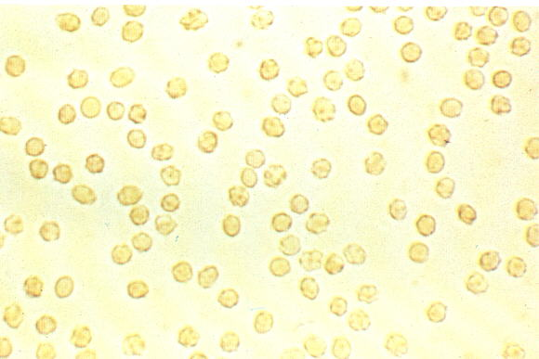
RBCs in the urine

Slide 15
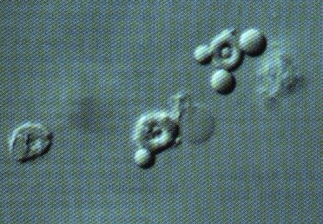
Which if coming from the glomerulus may produce the following dysmorphic RBC's:

Slide 16
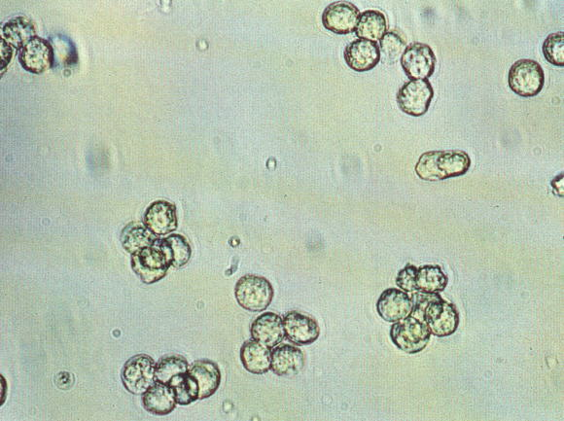
You may also see urine leukocytes:

Slide 17
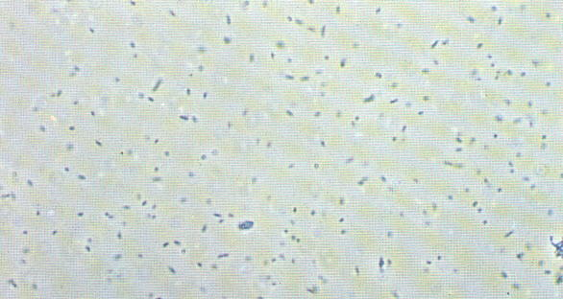
Associated with leukocytes would be the presence of bacteria. Recall that this is not a gram stain and thus the bacteria do not look the same as they would in the microbiology lab sample

Slide 18
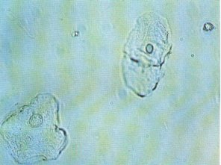
You may also look for contaminants such as a) squamous cells, b) cotton fibers and c) starch granules respectively:

Slide 19
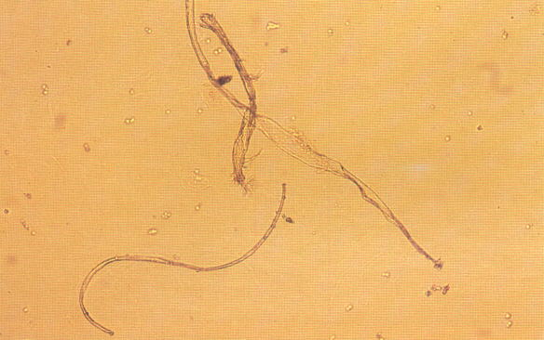
Cotton fibres

Slide 20
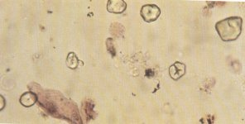
Starch granules

Slide 21
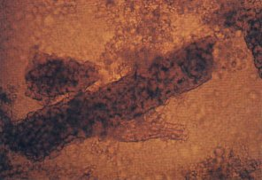
The RBC cast of glomerular pathology:

Slide 22
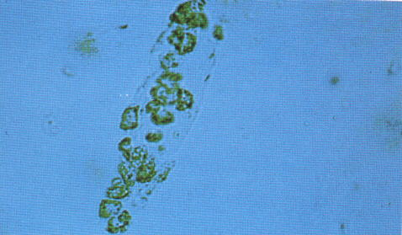
The WBC cast of pyelonephritis:

Slide 23
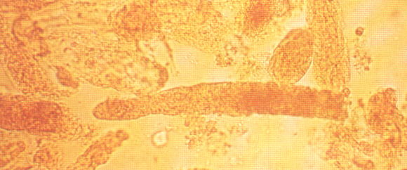
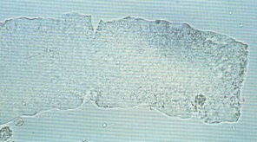
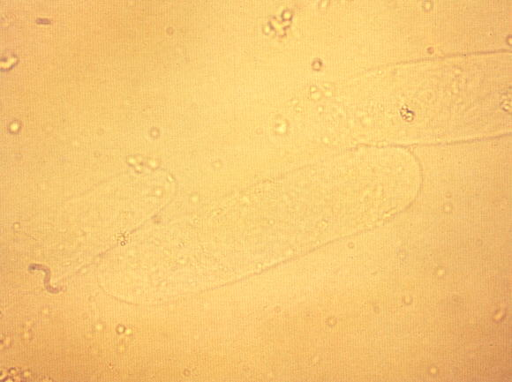
The nonspecific granular, waxy and hyaline casts:

Slide 24
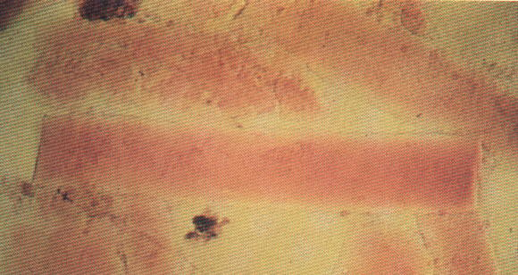
In contrast many would consider the finding of Broad casts as a sign of the markedly decreased output of chronic renal failure. They are usually quite wide and are upto 2-6 times as wide as the above nonspecific casts (thus the name "broad"):

Slide 25
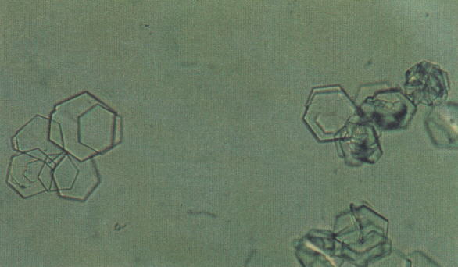
The pathologic crystals of metabolic diseases and poisonings can be seen as well: CYSTINE:

Slide 26
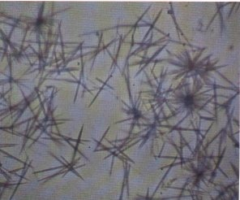
Tyrosine

Slide 27
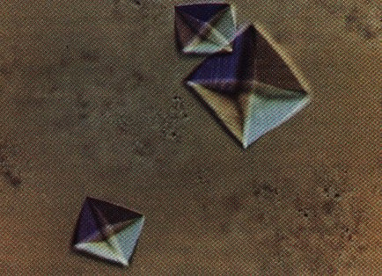
Calcium Oxalate

Slide 28
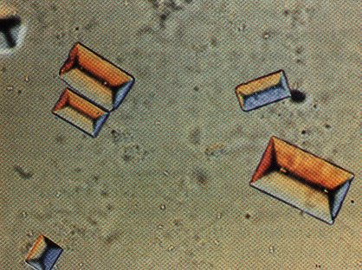
Finally one might find the "coffin-lid" struvite crystals associated with urea-splitting bacteria

Slide 29
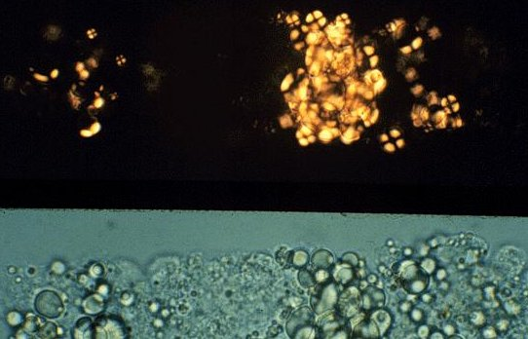
In patients with nephrotic syndrome one might be able to find fat casts:

Slide 30
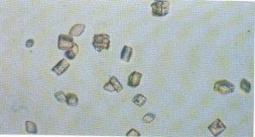
Uric acid crystals

Slide 31
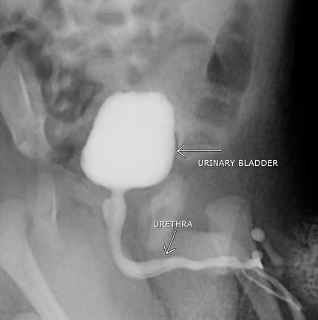

Slide 32
Micturating Cystourethrogram (MCUG)
Indications for imaging Vesicoureteric reflux in children - in recurrent UTI Stress incontinence Urethral stricture Bladder dysfunctions Contra Indications Current - urinary tract infection Contrast media allergies - cautions-

Slide 33
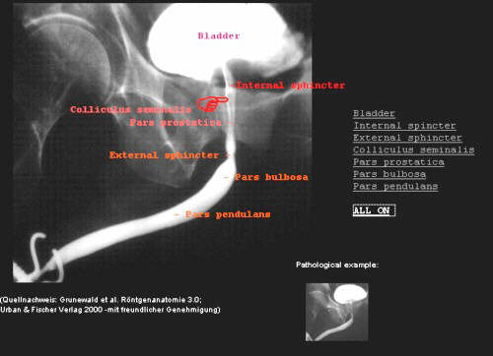
Anatomy Demonstrated

Slide 34
Urine examination (contd)
Dipsticks impregnated with chemicals which change colour

Slide 35
. Creatinine - product of creatine metabolism by the muscle. Is filtered by the kidney, but not absorbed in the renal tubule.
Formula for creatinine clearance: C=UV P
C = clearance rate U = urine concentration V = urine volume P = plasma concentration
Normal creatinine clearance is 115-125 ml/min (corrected for body surface area) Usually 24 hour collection with blood drawn when urine collection is completed.

Slide 36
What are the substances reabsorbed in the renal tubule?
Reabsorption: water, sodium, and other substances leave the lumen of the tubule and enter the blood.
Secretion: substances from the blood enter lumen of the tubule.
Glucose and amino acids - completely reabsorbed
Filtered water - 99% reabsorbed Urea - about 50% reabsorbed Creatinine - none Electrolytes - determined by need

Slide 37
. Renin - released by special cells located near the glomerulus (juxtaglomerular cells) in response to:
Reduction in GFR
Sympathetic stimulation - Combines with angiontensinogen, a plasma protein that circulates in the blood to form angiotensin I, then converted to angiotensin II (potent vasoconstrictor and stimulator of aldosterone release).
2. Erythropoietin - released in response to hypoxia. Acts on bone marrow to stimulate production and release of RBCs. Persons with chronic hypoxia often have increased RBCs (polycythemia) due to increased erythropoietin levels. Examples: congestive heart failure, chronic lung disease, living at high altitude.
3. Vitamin D - activated and converted in kidney. Affects calcium metabolism.
in kidney. Affects calcium metabolism.

Slide 38
. Urinalysis - Normal urine contains metabolic wastes and little, if any, plasma proteins, blood cells, or glucose.
Casts - molds of distal nephron lumen. Tamm and Horsfall mucoprotein (gel-like substance) forms the matrix of casts. Hyaline casts - contain Tamm and Horsfall mucoprotein, without cells. Develop when protein content of urine is high (such as nephrotic syndrome

Slide 42
Urinary Tract Infection
Midstream
Cleansing the meatus
Normal : 10000 or less / ml organisms
Infection : 100000 or more / ml organisms one type contaminants : staphylococcus, streptococcus, diphteroides,

Slide 43
Electromyography
Studies detecting the electrical activity of the detrusor muscle

Slide 44
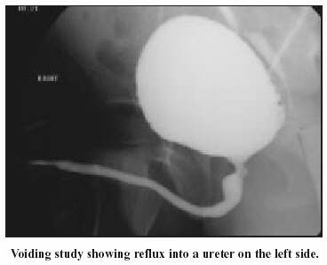

Slide 45
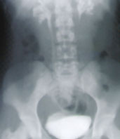
Voiding cystourethrogram revealing bilateral grade 3 reflux into small, scarred kidneys.

Slide 46
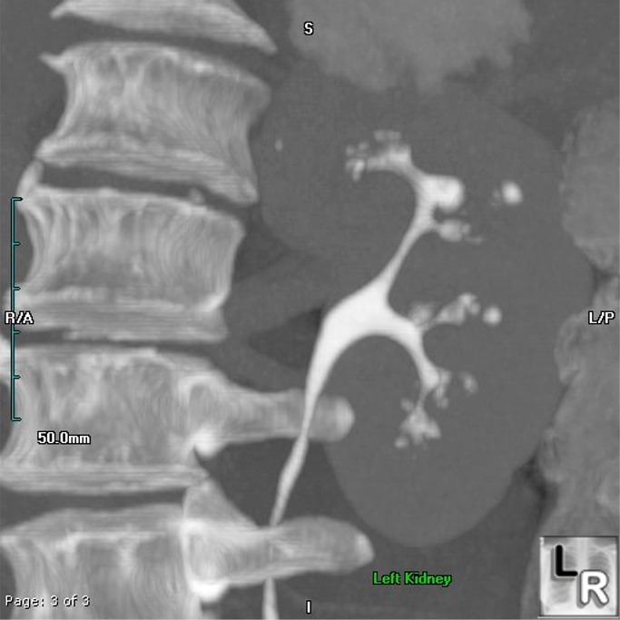
Renal papillary necrosis
Coronal image of the left kidney from a CT Urogram shows numerous irregular collections of contrast arising from the calyces, some streak-like densities and overall distortion of the normal medullary-calyceal anatomy

Slide 47
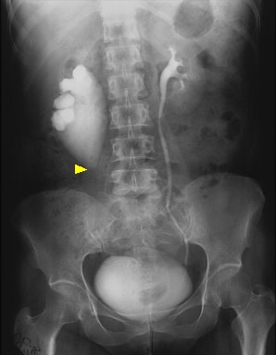
Ureteropelvic jn obstruction

